Slide 1
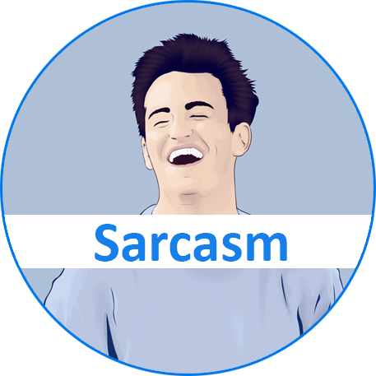




. .
R³ : Reverse, Retrieve, and Rank for Sarcasm Generation with Commonsense Knowledge
Tuhin Chakrabarty, Debanjan Ghosh, Smaranda Muresan and Nanyun (Violet) Peng

Slide 2
What is Sarcasm?
Sarcasm is a figure of speech used to mock or convey contempt
Nice perfume. How long did you marinate in it?
I made the genius choice of selling my car right before I decided to move

Slide 3
Sarcasm Factors
Be evaluative
Be based on a reversal of valence between the literal and intended meaning
Be based on a semantic incongruity with the context, which can include shared common sense or world knowledge between the speaker and addressee
Be aimed at some target
Be relevant to the communicative situation in some way

Slide 4
Task Definition
Starting from an evaluative non-sarcastic utterance, generate a sarcastic utterance that keeps the speaker's intended meaning.
Notes:
Here say we simplify the task, but say that our generated sarcastic message should have the first 4 characteristics

Slide 5
A Few Examples
Non Sarcastic
Battery life on this phone is terrible.
Sarcastic
Battery life on this phone is great. When he tried to call again, he could no longer get a dial tone.

Slide 6
A Few Examples
Non Sarcastic
This is a horrible music video.
Sarcastic
This is a great music video. Let’s take a look at the ear damage

Slide 7
What Does GPT-2 Say?
Battery life on this phone is great and I have a lot of standby time between charging and using the phone.
This is a great music video. Definitely a must have.

Slide 8
Generating Sarcasm is Challenging
No large parallel corpus of non-sarcastic to sarcastic text to train a generative model.
Even if a large parallel corpus exists, learning the distribution of existing data and sampling from it will likely just mimic/memorize, rather than generate truly novel, creative sarcasm.
Notes:
I feel the Creative composition sign is not needed and is distracting...

Slide 9

Our approach
Given the lack of training data for sarcasm generation, we propose a novel unsupervised approach that has three main components inspired by the sarcasm factors
Reversal of Valence
Retrieval of Common sense Context
Ranking of Semantic Incongruity

Slide 10
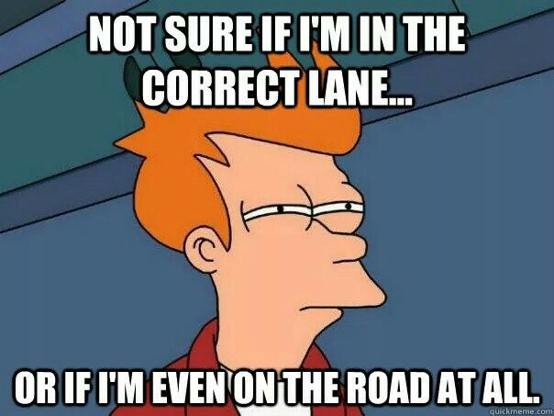
Lets see how it makes Sarcasm better
Non-Sarcastic : Zero visibility in fog makes driving difficult.

Slide 11

Reversal Of Valence
Zero visibility in fog makes driving difficult easy.

Slide 12

Retrieval Of Commonsense Context
Zero visibility in fog makes driving difficult easy. It is advisable to insure your life against accident.

Slide 13

Ranking Of Semantic Incongruity
Zero visibility in fog makes driving difficult easy. Suffered three cracked ribs in the accident.

Slide 14
Human written Sarcasm
Driving is nice with zero visibility.
Notes:
Now contrast to the human and bring up that our generation can sometimes be better than human written sarcasms.

Slide 15
System Overview
zero visibility in fog makes driving easy
zero visibility in fog makes driving easy. suffered three cracked ribs in the accident.
REVERSE
CONCAT
REVERSAL OF VALENCE
NON-SARCASTIC UTTERANCE REVERSED
TOP RANKED
SENTENCE
SARCASTIC
OUTPUT
RANKING OF
SEMANTIC
INCONGRUITY
NON-SARCASTIC UTTERANCE INPUT
zero visibility in fog makes driving difficult
ROBERTA LARGE
FINE-TUNED ON
MNLI
POS TAGGING
FORM CANDIDATE
PAIRS FOR NLI
Inputs: zero, visibility,
fog,makes, driving, difficult
INCONGRUITY RANKING
RETRIEVAL OF COMMONSENSE CONTEXT
COMET
(GPT-2 FINE-TUNED
ON CONCEPTNET)
Output: accident
RETRIEVAL
CAUSES
COMMONSENSE
TERM / PHRASE
suffered three cracked ribs in the accident.
I injured my spine in a riding accident.
…...

Slide 16
zero visibility in fog makes driving easy
REVERSE
REVERSAL OF VALENCE
NON-SARCASTIC UTTERANCE REVERSED
NON-SARCASTIC UTTERANCE INPUT
zero visibility in fog makes driving difficult

Slide 17
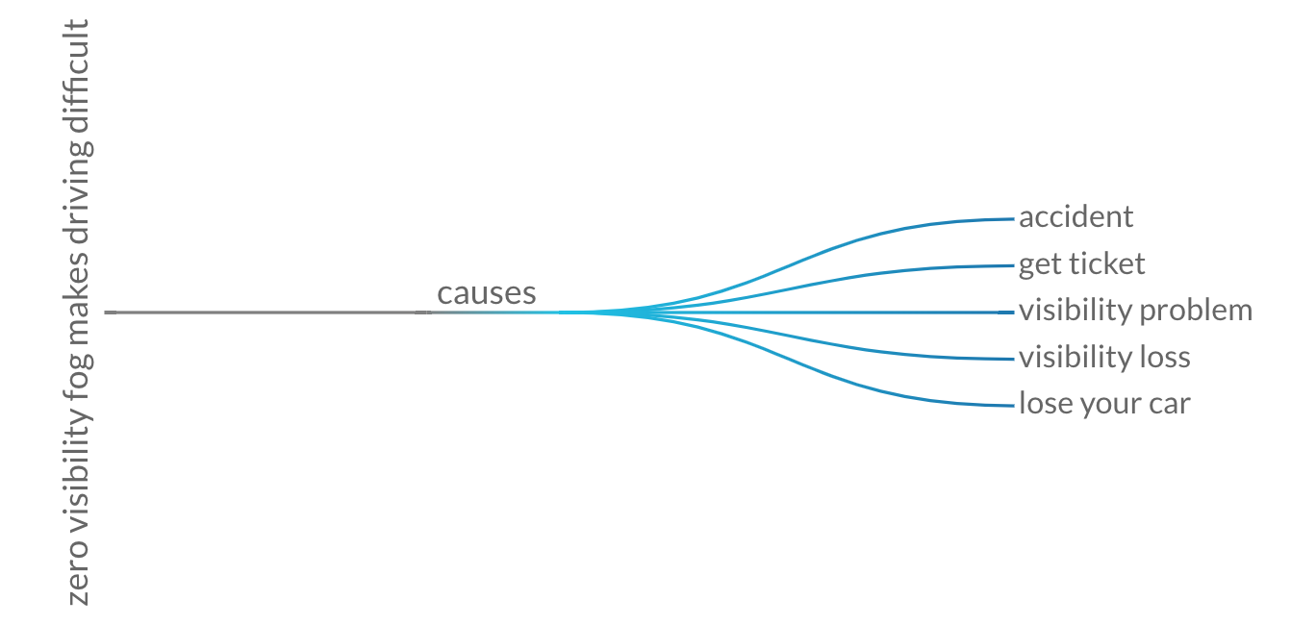
NON-SARCASTIC UTTERANCE INPUT
zero visibility in fog makes driving difficult
POS TAGGING
COMET (Bosselut et al 2019)
Inputs: zero, visibility,
fog,makes, driving, difficult
RETRIEVAL OF COMMONSENSE CONTEXT
COMET
(GPT-2 FINE-TUNED
ON CONCEPTNET)
Output: accident
RETRIEVAL
suffered three cracked ribs in the accident.
I injured my spine in a riding accident.
…...
CAUSES
COMMONSENSE
TERM / PHRASE

Slide 18
zero visibility in fog makes driving easy
zero visibility in fog makes driving easy. suffered three cracked ribs in the accident.
REVERSAL OF VALENCE
CONCAT
NON-SARCASTIC UTTERANCE REVERSED
TOP RANKED
SENTENCE
SARCASTIC
OUTPUT
RANKING OF
SEMANTIC
INCONGRUITY
ROBERTA LARGE
FINE-TUNED ON
MNLI
FORM CANDIDATE
PAIRS FOR NLI
INCONGRUITY RANKING
suffered three cracked ribs in the accident.
I injured my spine in a riding accident.
…...
Notes:
After this Add again the overall slide and add R^3 As name in the corner left.

Slide 19
zero visibility in fog makes driving easy
zero visibility in fog makes driving easy. suffered three cracked ribs in the accident.
REVERSE
CONCAT
REVERSAL OF VALENCE
NON-SARCASTIC UTTERANCE REVERSED
TOP RANKED
SENTENCE
SARCASTIC
OUTPUT
RANKING OF
SEMANTIC
INCONGRUITY
NON-SARCASTIC UTTERANCE INPUT
zero visibility in fog makes driving difficult
ROBERTA LARGE
FINE-TUNED ON
MNLI
POS TAGGING
FORM CANDIDATE
PAIRS FOR NLI
INCONGRUITY RANKING
Inputs: zero, visibility,
fog,makes, driving, difficult
RETRIEVAL OF COMMONSENSE CONTEXT
COMET
(GPT-2 FINE-TUNED
ON CONCEPTNET)
Output: accident
RETRIEVAL
suffered three cracked ribs in the accident.
I injured my spine in a riding accident.
…...
CAUSES
COMMONSENSE
TERM / PHRASE

Slide 20
Evaluation Setup
Test Set
Test on 150 randomly selected non sarcastic utterance
Evaluation Criterion
Creativity
Sarcasticness
Humor
Grammaticality
Notes:
Maybe make this slide Evaluation Setup and have “Test Set” and “Evaluation Criteria” as subbullets.

Slide 21
Ablations
Reversal of Valence (RV)
No Reversal of Valence (NoRV)
No Semantic Incongruity (NSI)
SOTA (Hybrid reinforced seq2seq model Mishra et al 2019)
Full Model (FM)
Human (Gold) Sarcasm

Slide 22
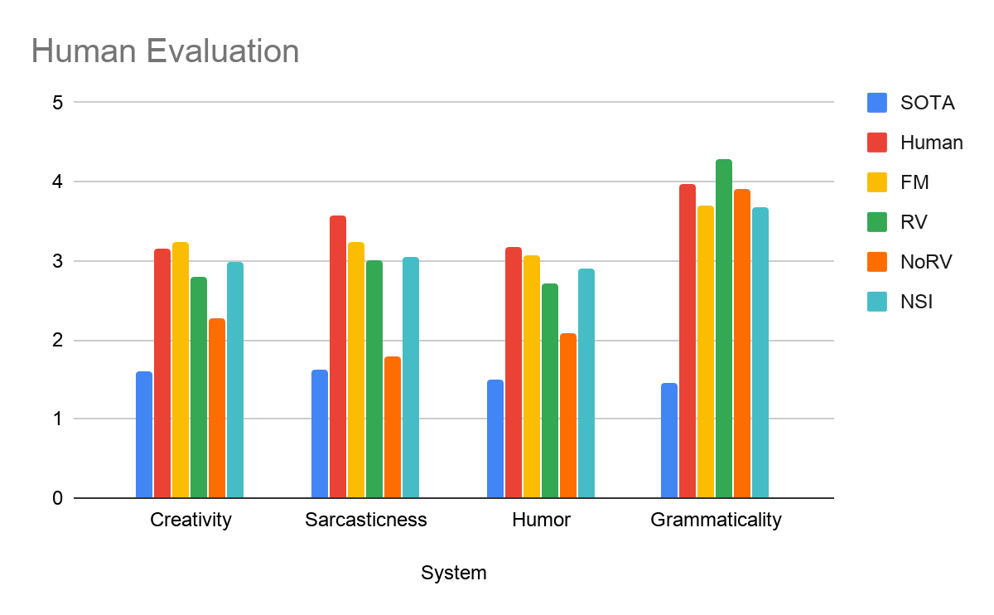
Results

Slide 23
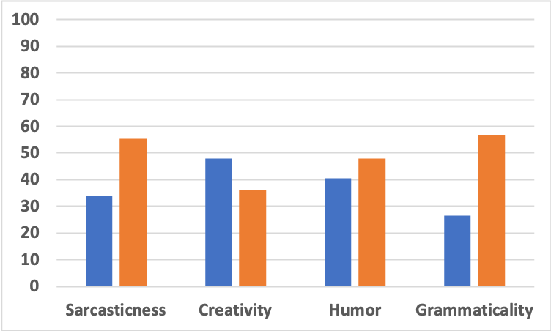
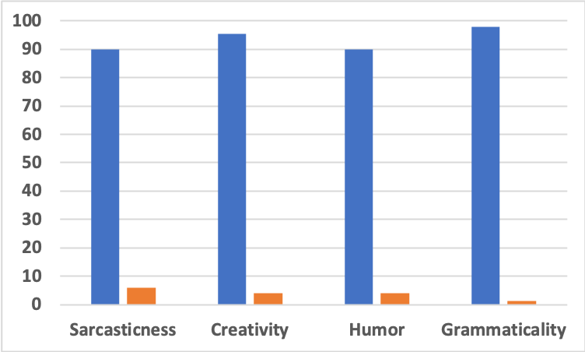
Pairwise Game
FM Vs. Human
FM Vs. SOTA
90.0 6.0 95.3 4.0 90.0 4.0 98.0 1.3
34.0 55.3 48.0 36.0 40.6 48.0 26.6 56.6
Win
Loss

Slide 24
Summary
Big LMs mimicking existing materials are not likely to generate truly novel, creative sentences.
Structure and inductive bias are needed
We propose a theoretically inspired approach and use a retrieve-and-edit method employing common sense knowledge to generate novel sarcasm without training on sarcasm corpora.
Our system is much better than existing baselines, but still behind human performance
Creative Figurative language generation is hard and interesting! Come work on it!

Slide 25
Thanks!
Questions?
https://github.com/tuhinjubcse/SarcasmGeneration-ACL2020

